Slide 1
K^{th} Order Approximation:
Shifted Beam
May 26 2020
Shift expansion analysis (at waist,z=0):
  Gaussian
  0-100 micron offset tophat (34)
  Computation times
    Tophat ,varied max mode order

Slide 2
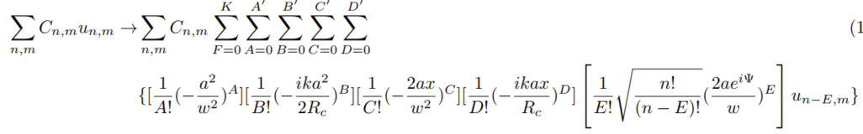
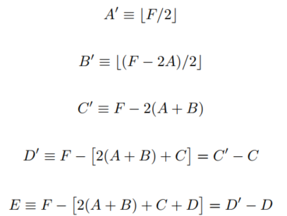
K^{th} Order Approximation: Shifted Beam

Slide 3
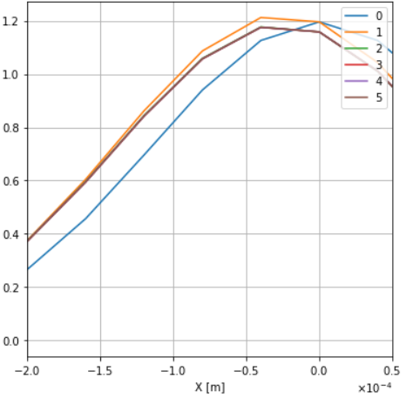
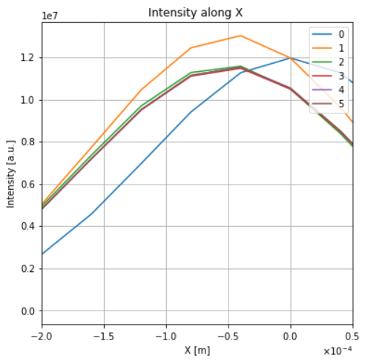
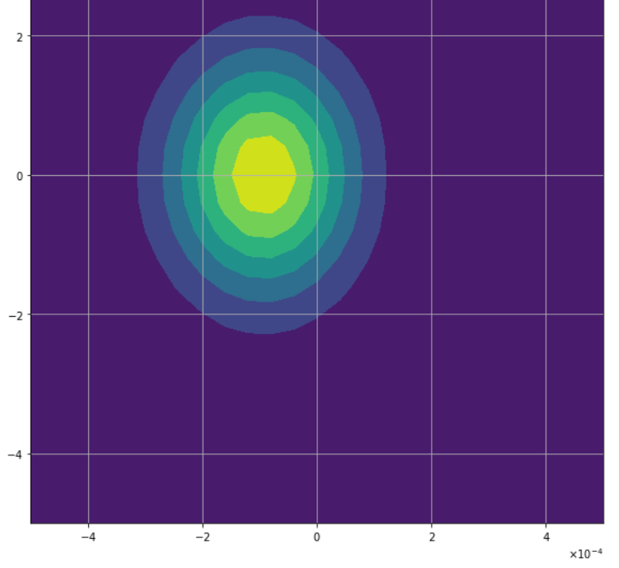
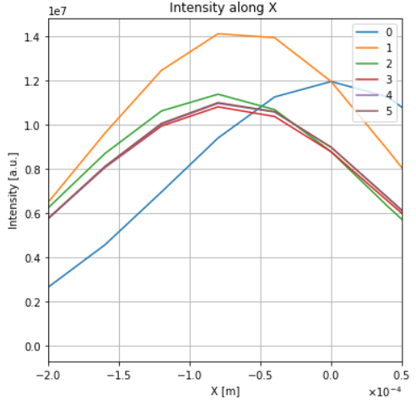
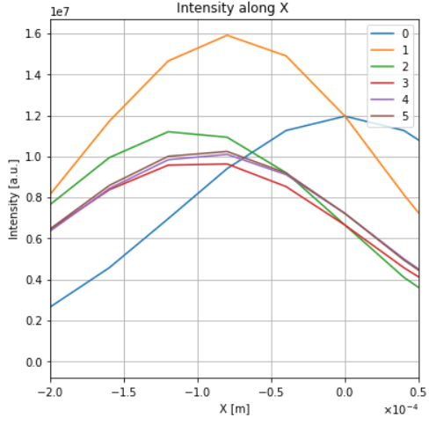
Shifted Gaussian
Intensity contour (100 micron) right
Intensity at y=0 below
Vertical lines show expected shift
  (L to R: 25,50,75,100um)
Intensity (a=100um,5th order)
(image was low res)

Slide 4
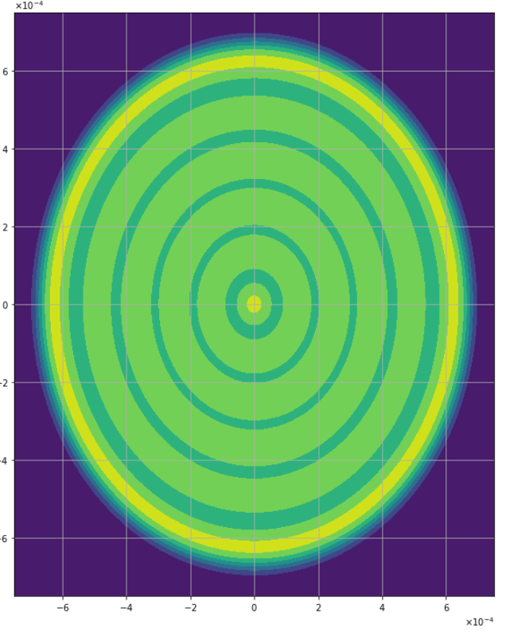
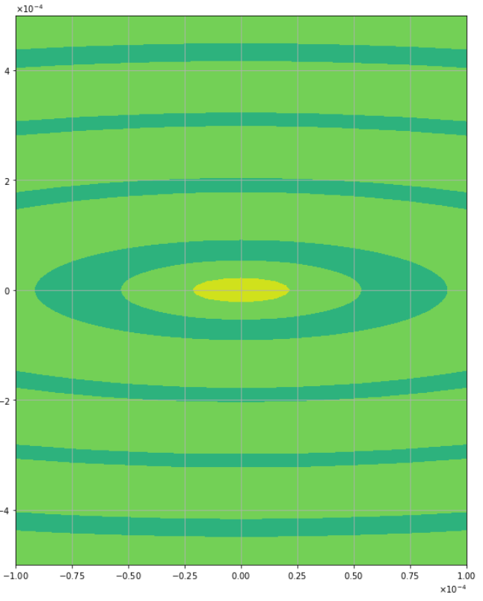
Shifted Tophat at Waist
Shifts for 25, 50, 75, 100 micron
Basis: beam radius = 1/3mm,w₀~ 0.2 mm
Full mode order 34
Intensity Resolution = 200x200
  Full plot above zoomed plot
K = approximation order
Convergence results:
  25um at K=2
  50um at K=6
  75 um at K=8?
  100 um at??

Slide 5
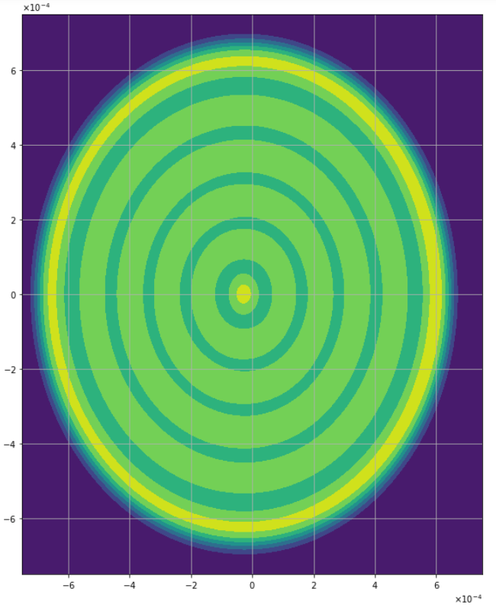
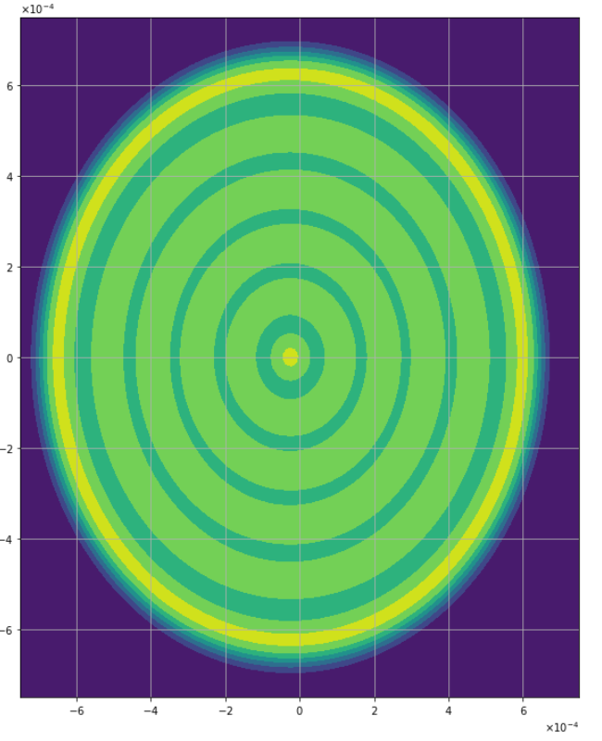
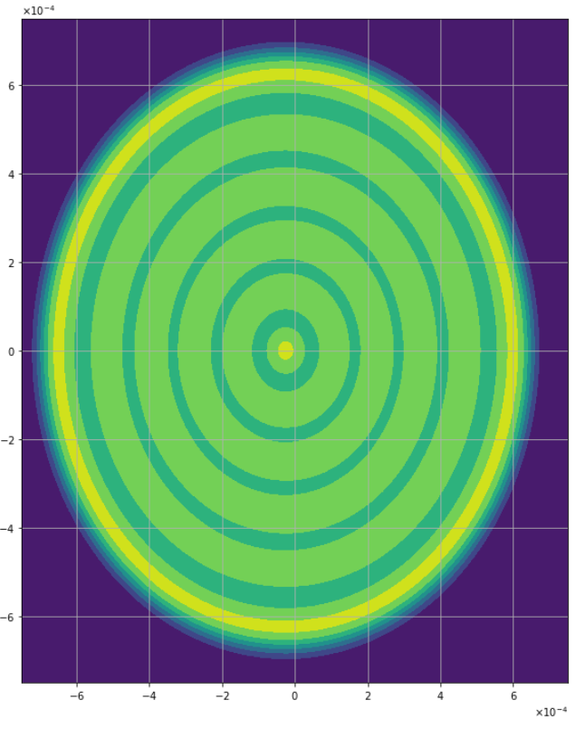
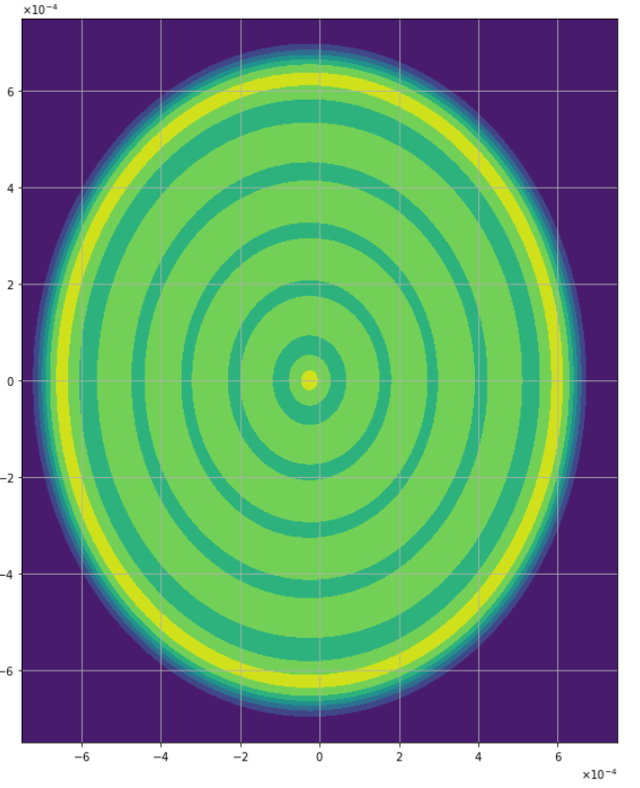
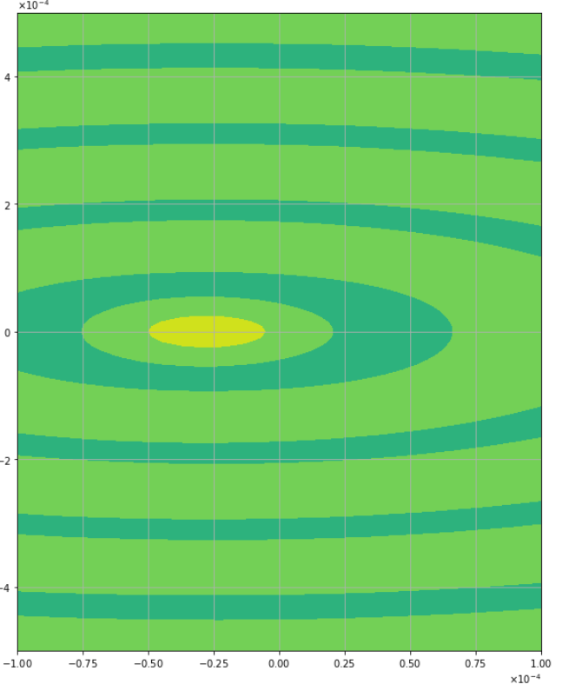
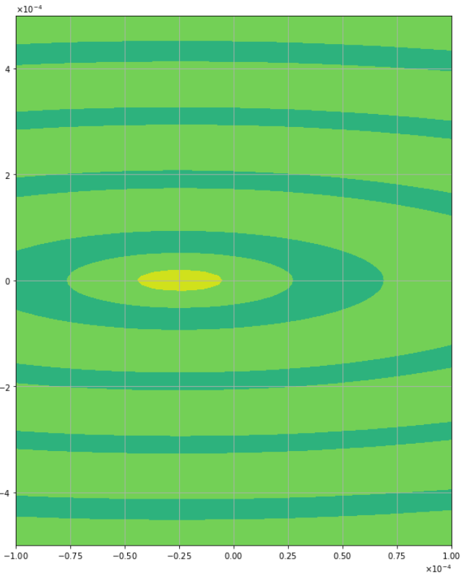
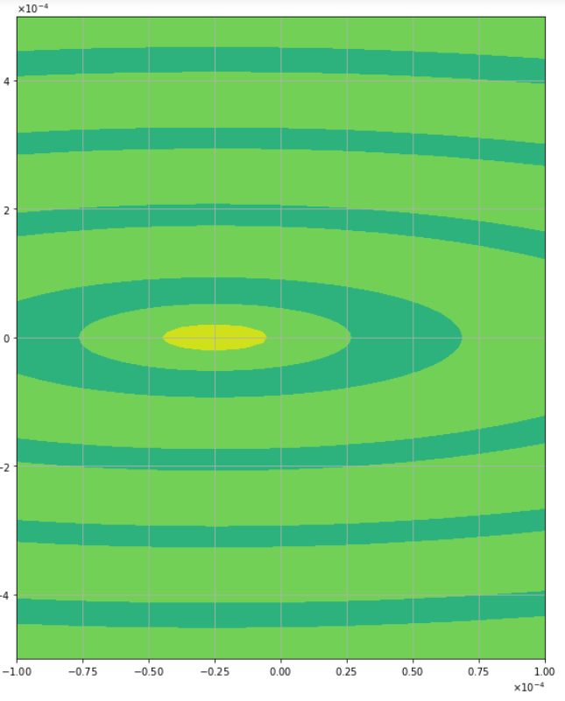

25 micron
K=2
K=4
K=6
K=8

Slide 6
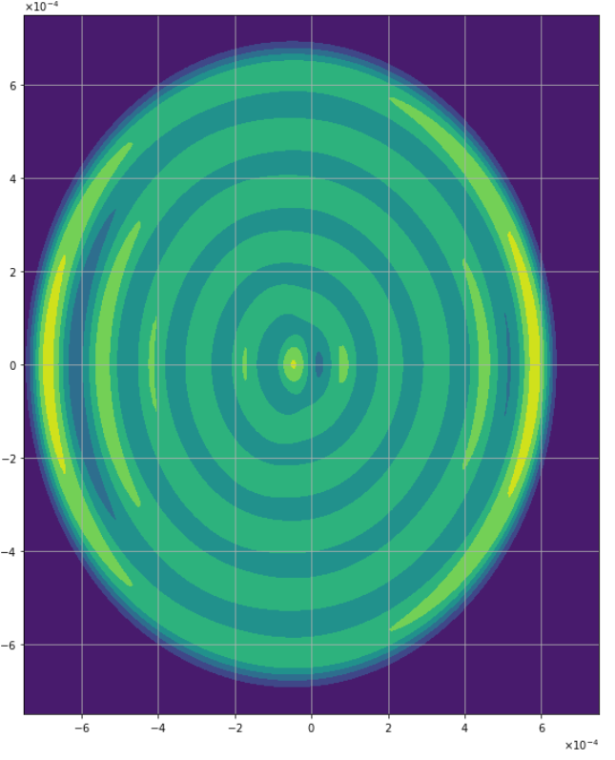
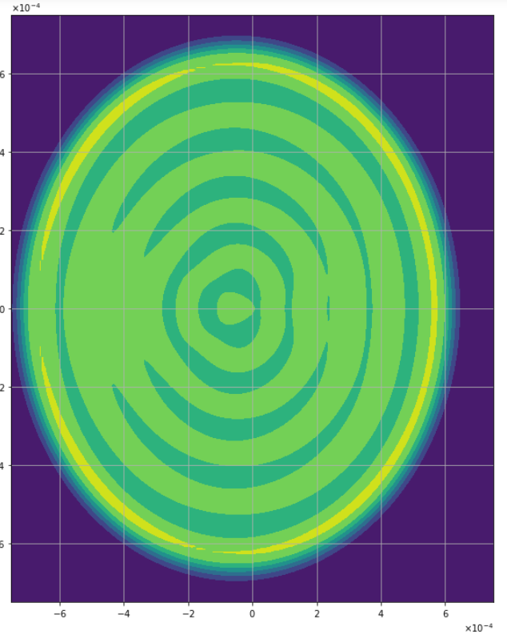
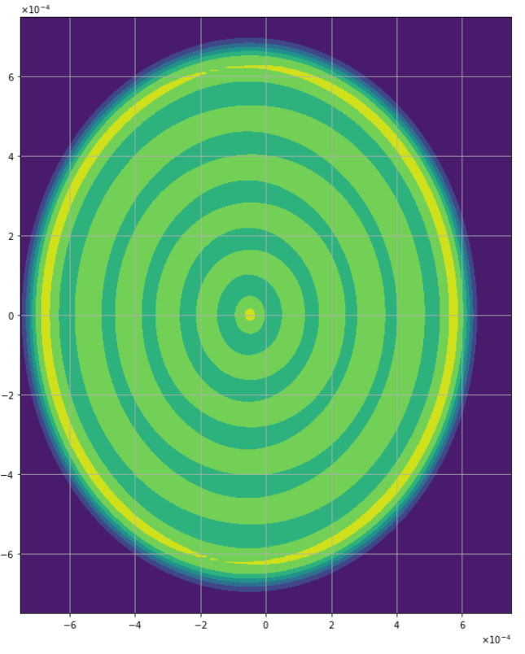

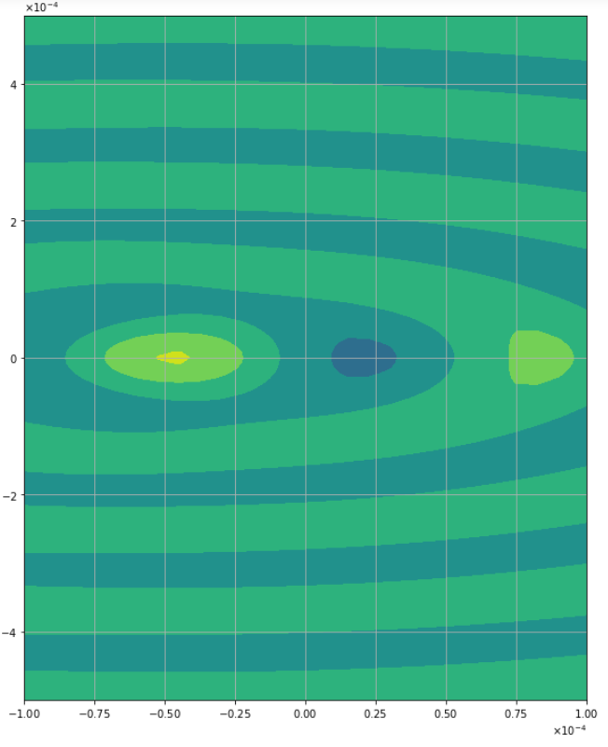
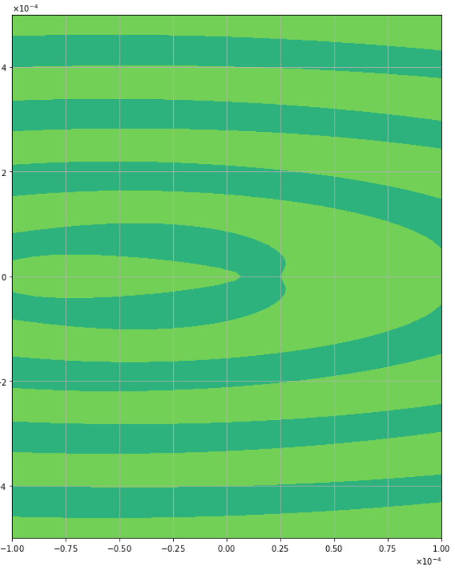
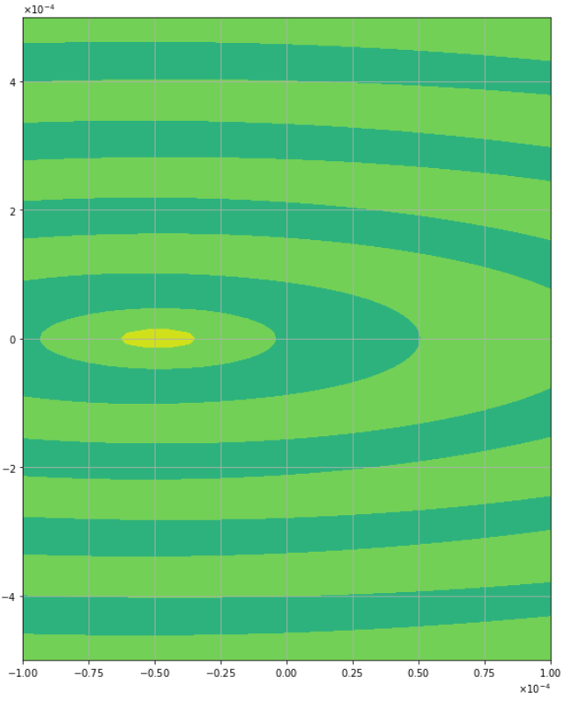
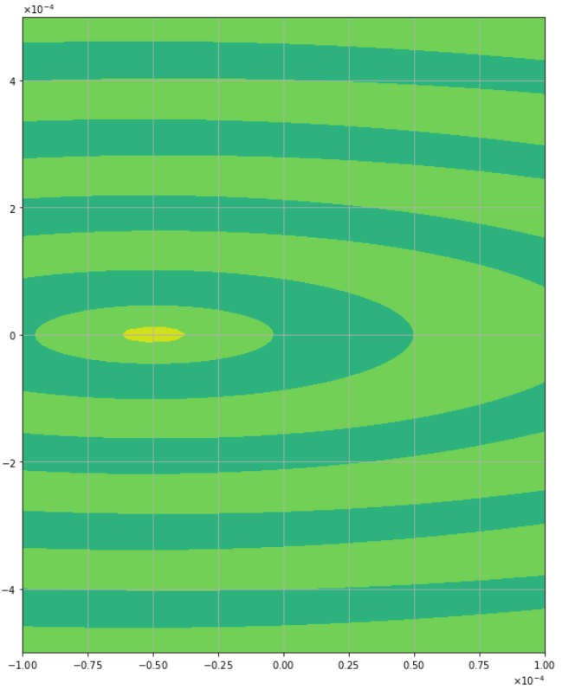
50 micron
K=2
K=4
K=6
K=8

Slide 7
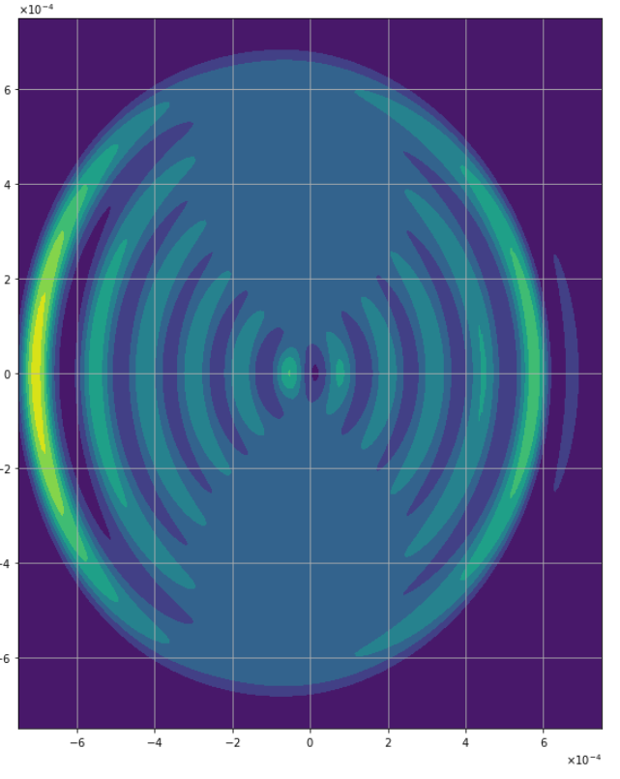
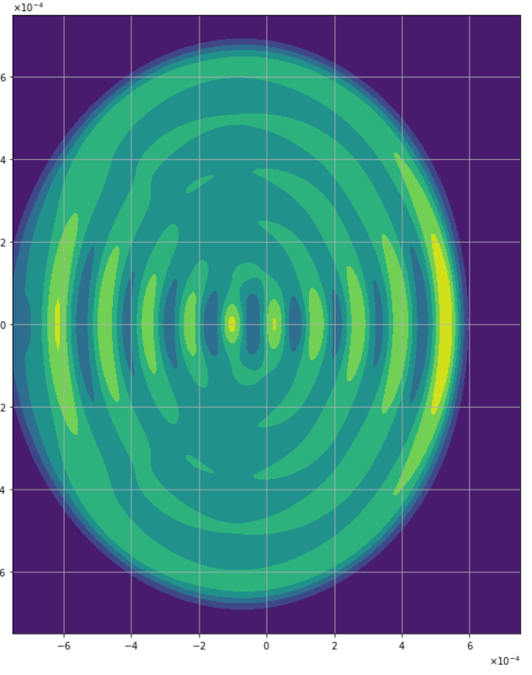
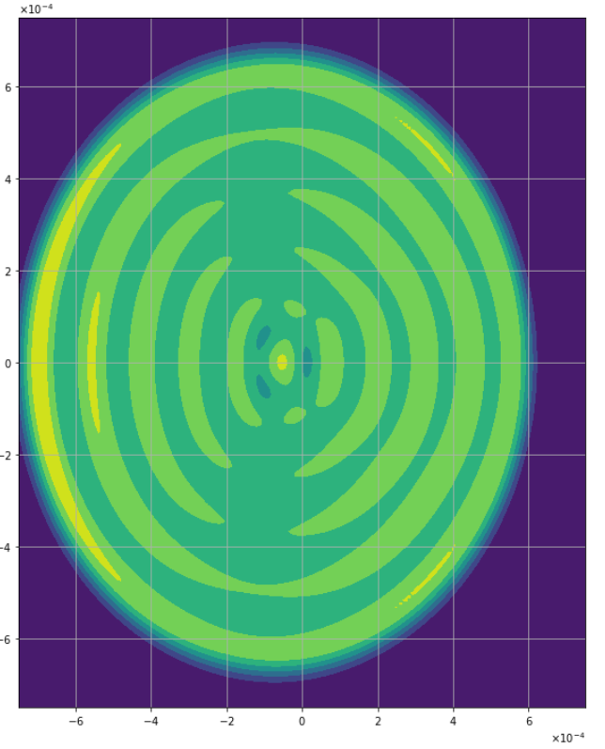
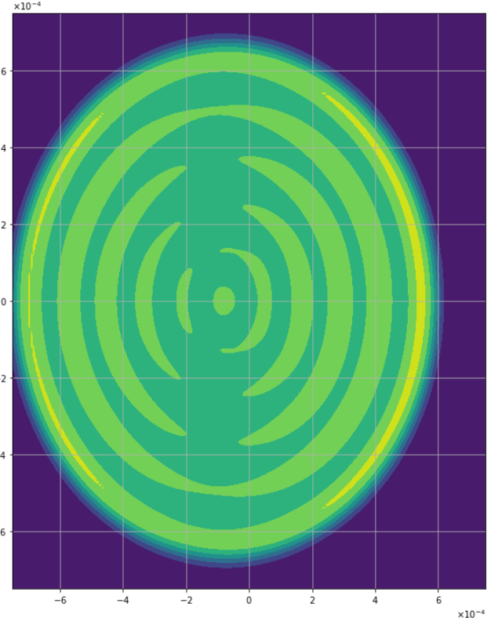
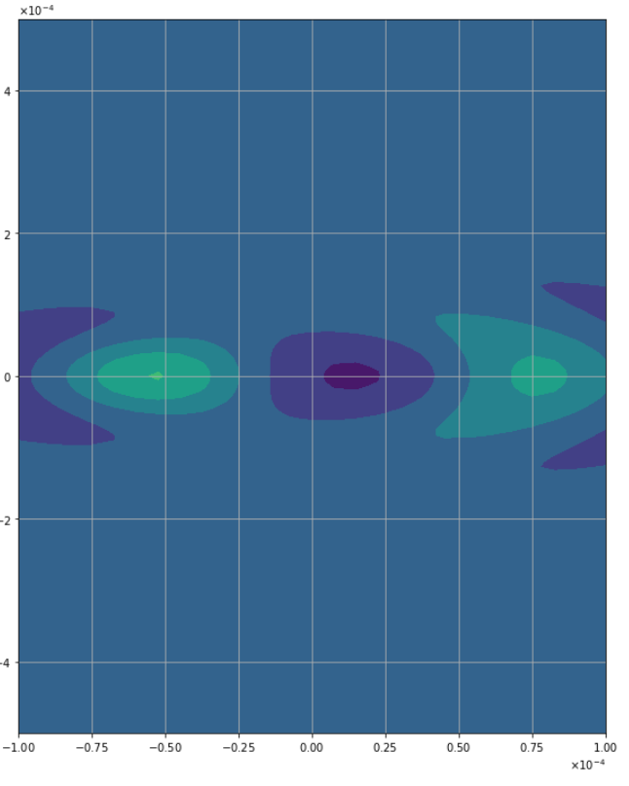
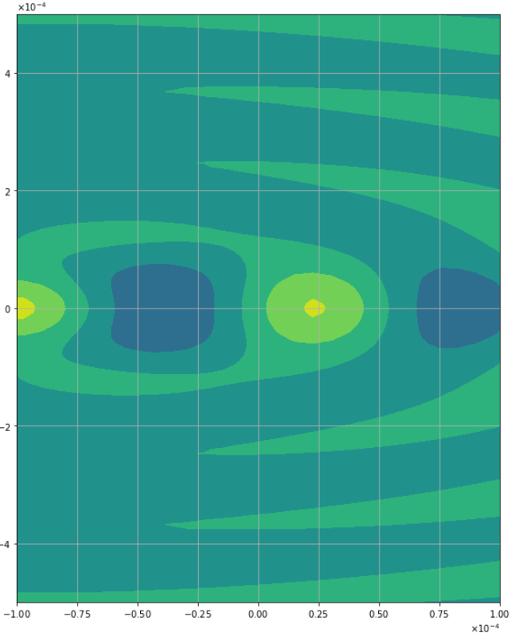
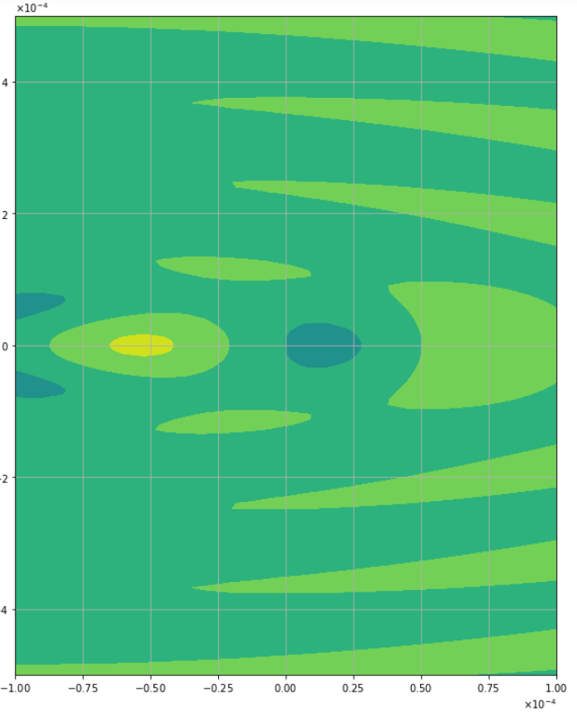
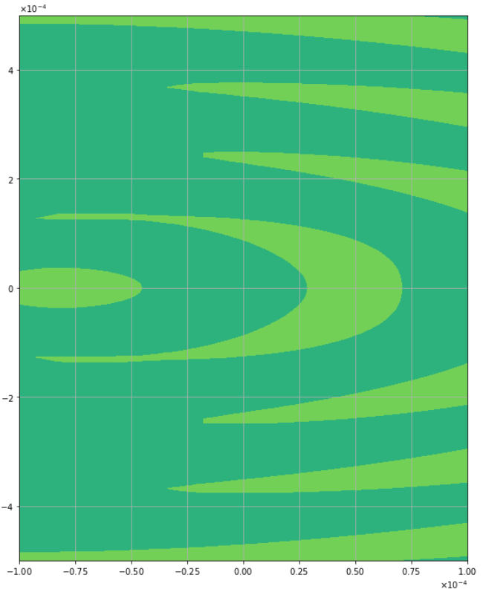
75 micron
K=2
K=4
K=6
K=8

Slide 8
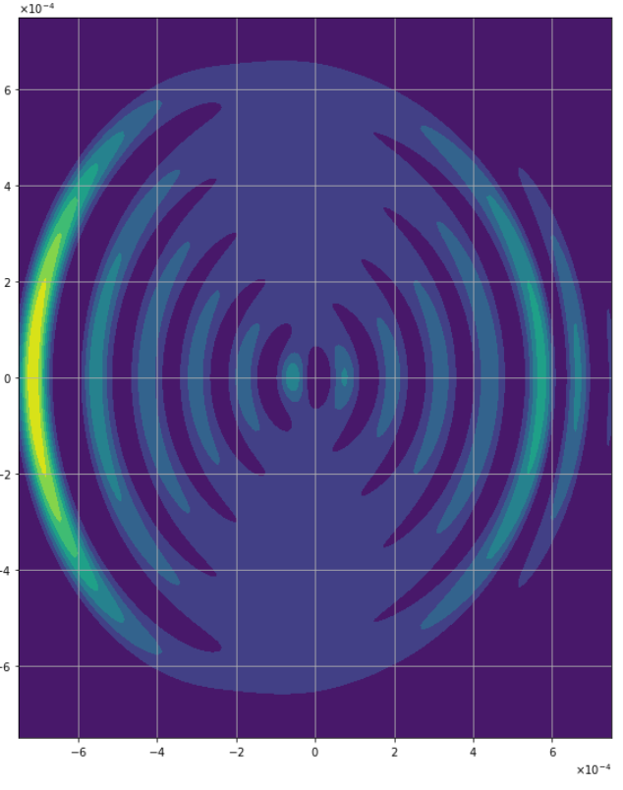
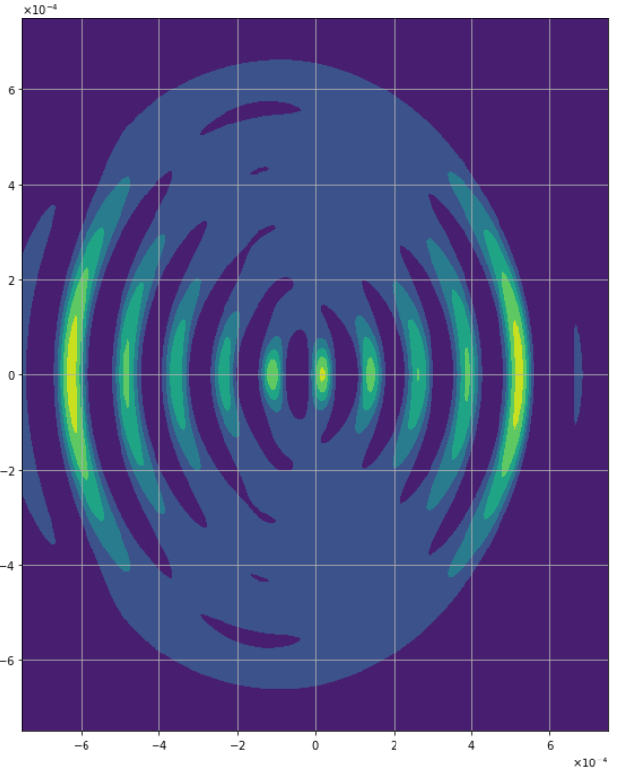
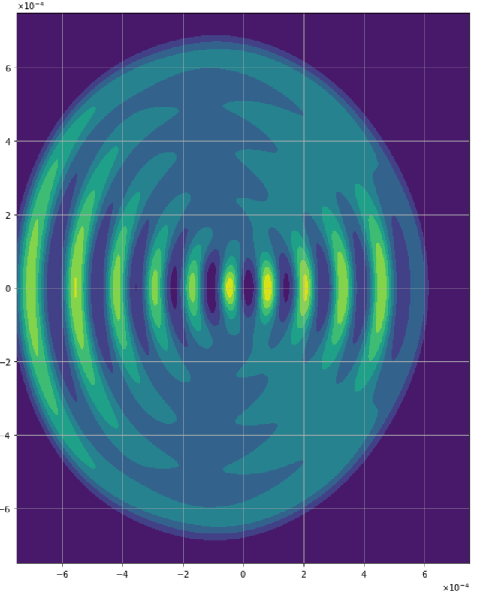
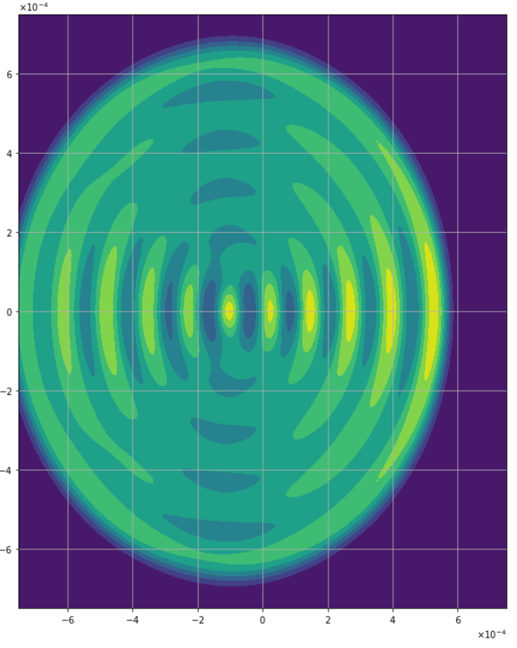
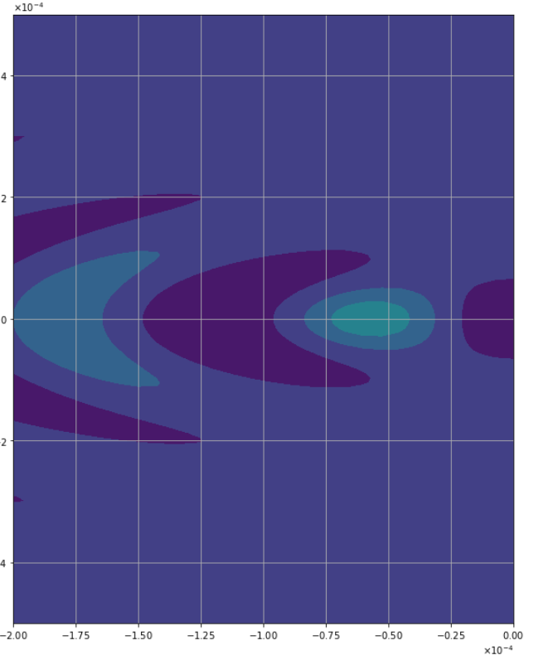
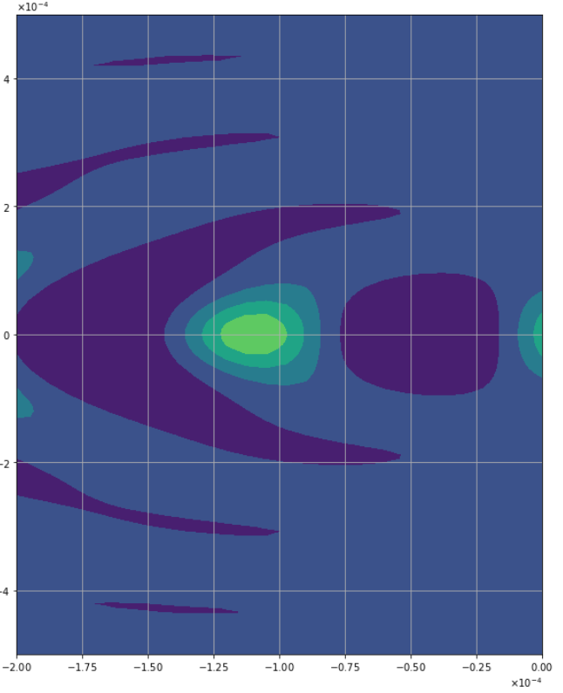
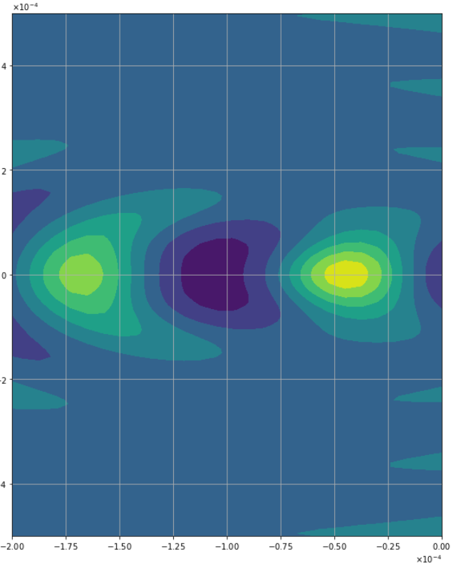
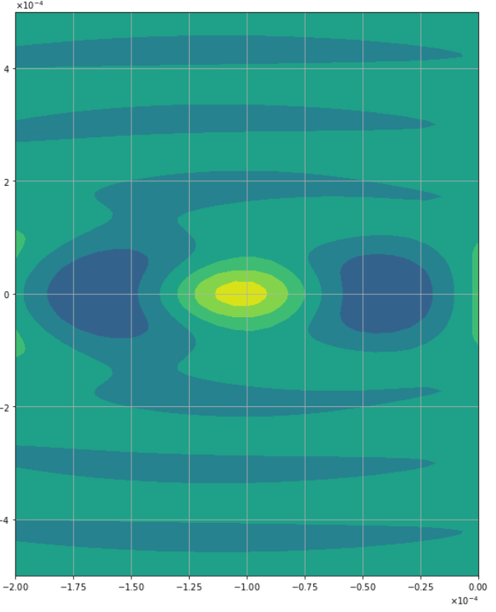
100 micron
K=2
K=4
K=6
K=8

Slide 9
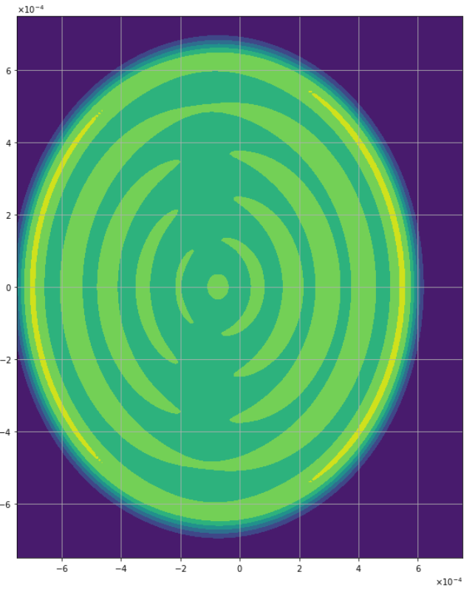
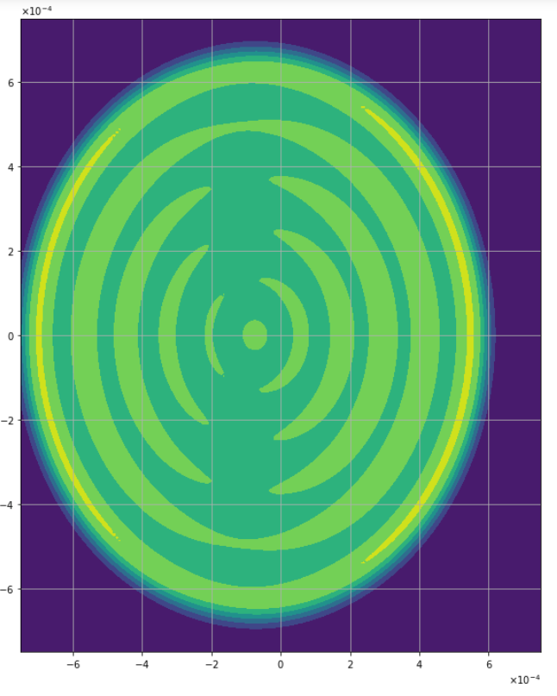
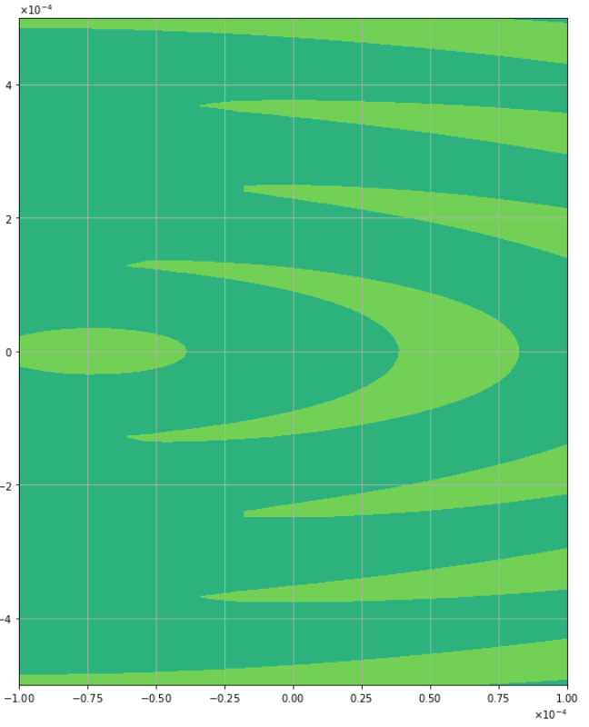
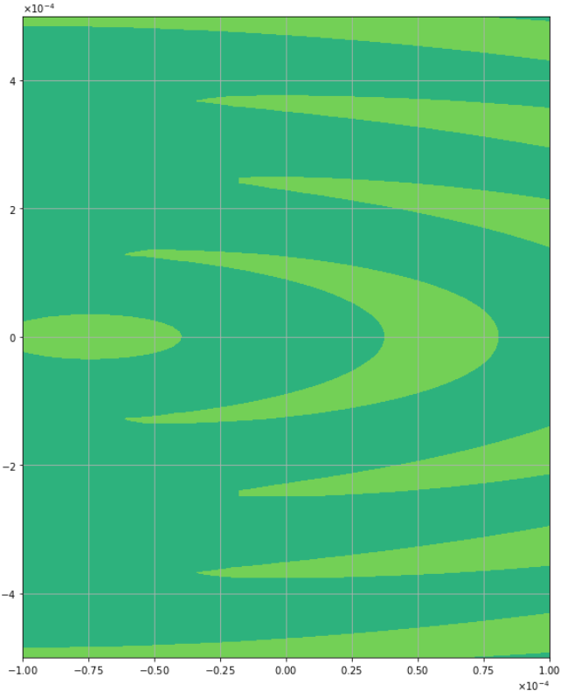
75 micron (revisited)
K=8
K=10
K=12

Slide 10
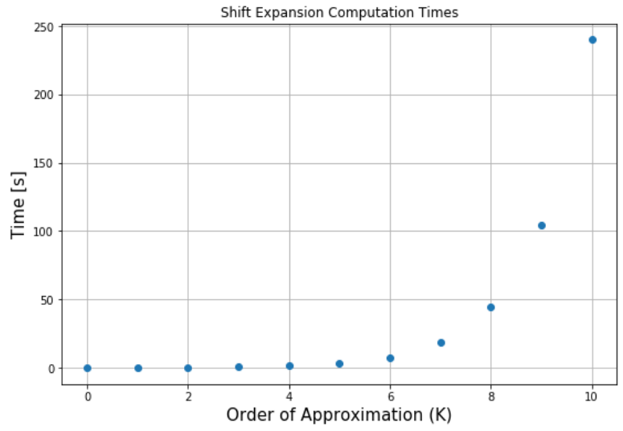
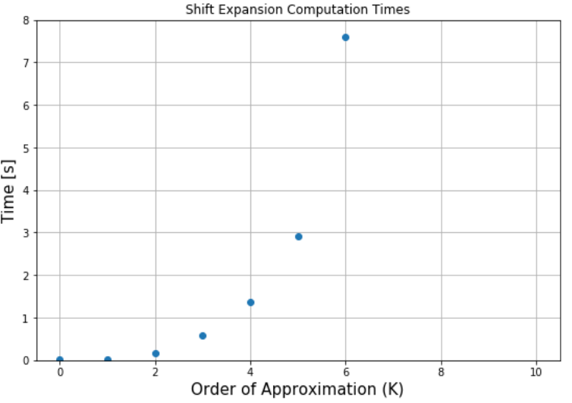
Performing the expansion for updated C_{nm} ( no signal calc. or tilt)
Up to 10th order:
  a¹⁰ terms
  x¹⁰ terms
Mode order 34 tophat -> order 44 after x transformations
Computation Times
[0.015625, 0.015625, 0.15625, 0.59375, 1.359375, 2.921875, 7.609375, 18.953125, 44.234375, 104.390625, 240.046875]

Slide 11
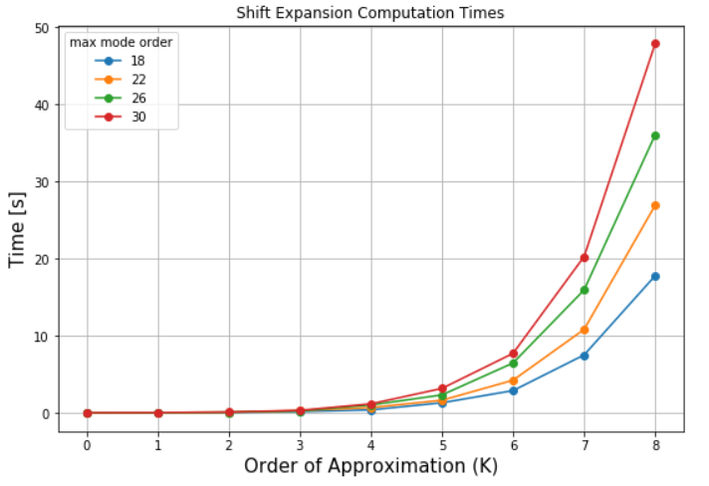
Computation Times: Varying Tophat Max Mode Order
Same scenario as previous slide
Times shown below

Slide 12

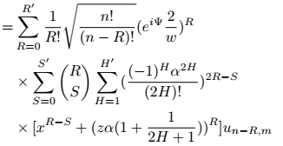
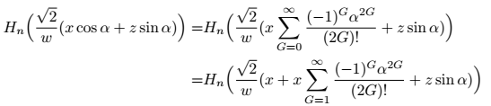
J-th order Tilt Sneak-peek

Slide 13

What’s Next?
Proposal | Time?
More 1st order tilt-shift results | ?
More shift analysis, signals with 1st order tilt, K^{th} order shift | < 1 week
Simplified J^{th} order tilt solution, signals with K^{th} order shift | ~ 1-2 weeks
Full J^{th} order tilt solution | ~ 3-4 weeks

